Slide 1
5 Usable Ethical Theories
Thursday Jan. 17 and Tuesday Jan. 22

Slide 2
Ethics Test (Jan. 24)
10/12 questions
Approximately 2 sentences per question.
Sample Question:
What are 2 formulations of the categorical imperative?
Key terms (concepts):
Categorical imperative; act/rule utilitarianism (similarities and differences); Social Contract Theory; Rawls’s 2 principles of justice; virtues and vices; measuring pleasure/pain
Key terms (examples):
Lying; distributive principle of justice; best allocation of resources; Pros and cons of each ethical theory (not all of them)

Slide 3
IT and Me assignment (Feb. 21st)
Phones are the paradigmatic IT commodity of our age.
Track your phone usage for a week and record the data.
Write a 600 word reflection paper on your use of your phone.
Reflect on your use of your phone and the various ethical issues that such use gives rise to. Consider:
How it impacts you personally (e.g. screen addiction, productivity, informative)
How it impacts your relationship with others (positive/negative)
How it affects your work (positive/negative)
How it impacts the environment/the broader world

Slide 4
2.6 Kantianism

Slide 5
Critical Importance of Good Will
Good will: the desire to do the right thing
Immanuel Kant: Only thing in the world that is good without qualification is a good will
XS – what is an example of happiness that is at odds with a good will?
Reason should cultivate desire to do right thing

Slide 6
Categorical Imperative (1st Formulation)
Act only from moral rules that you can at the
same time will to be universal moral laws.

Slide 7
Illustration of 1st Formulation
Question: Can a person in dire straits make a promise with the intention of breaking it later?
Proposed rule: “I may make promises with the intention of later breaking them.”
The person in trouble wants his promise to be believed so he can get what he needs.
Universalize rule: Everyone may make & break promises
Everyone breaking promises would make promises unbelievable, contradicting desire to have promise believed
The rule is flawed. The answer to the question is “No.”

Slide 8
Another Way to Reason It Out
Question: Can I make a promise with the intention of breaking it later?
I want my false promise to be believed.
In order for my false promised to be believable, I want everyone except myself to be truthful all the time.
In other words, I want to privilege my needs and desires over those of everyone else.
Contradiction between what I want to do and what I want others to do.
Therefore, what I am considering doing is wrong.

Slide 9
A Quick Check
When evaluating a proposed action, reverse roles
What would you think if that person did the same thing to you?
Negative reaction → evidence that your will to do that action violates the Categorical Imperative

Slide 10
Categorical Imperative (2nd Formulation)
Act so that you treat both yourself
and other people as ends in themselves
and never only as a means to an end.
This is usually an easier formulation to work
with than the first formulation of the
Categorical Imperative.

Slide 11
Kant: Wrong to Use Another Person Solely as a Means to an End

Slide 12
Plagiarism Scenario (p. 70)
Carla
Single mother
Works full time
Takes two evening courses/semester
History class
Requires more work than normal
Carla earning an “A” on all work so far
Carla doesn’t have time to write final report
Carla purchases report; submits it as her own work

Slide 13
Kantian Evaluation (1st Formulation)
Carla wants credit for plagiarized report
Rule: “You may claim credit for work performed by someone else”
If rule universalized, reports would no longer be credible indicator’s of student’s knowledge, and professors would not give credit for reports
Proposal moral rule is self-defeating
It is wrong for Carla to turn in a purchased report

Slide 14
Kantian Evaluation (2nd Formulation)
Carla submitted another person’s work as her own
She attempted to deceive professor
She treated professor as a means to an end
End: passing the course
Means: manipulate professor
What Carla did was wrong

Slide 15
Case for Kantianism
Treats all persons as moral equals
Gives all people moral worth as rational, autonomous beings
Holds everyone to the same standard
Produces universal moral guidelines

Slide 16
Perfect and Imperfect Duties
Perfect duty: duty obliged to fulfill without exception
Example: Telling the truth
Imperfect duty: duty obliged to fulfill in general but not in every instance
Example: Helping others
XS – multiple means of carrying it out.

Slide 17
Case Against Kantianism
Sometimes no rule adequately characterizes an action
Sometimes there is no way to resolve a conflict between rules
In a conflict between a perfect duty and an imperfect duty, perfect duty prevails
In a conflict between two perfect duties, no solution
Kantianism allows no exceptions to perfect duties
Conclusion: Despite weaknesses, a workable ethical theory

Slide 18
2.7 Act Utilitarianism

Slide 19
Principle of Utility
Jeremy Bentham and John Stuart Mill
An action is good if its benefits exceeds its harms
An action is bad if its harms exceed its benefits
Utility: tendency of an object to produce happiness or prevent unhappiness for an individual or a community
Happiness = advantage = benefit = good = pleasure
Unhappiness = disadvantage = cost = evil = pain

Slide 20
Principle of Utility (Greatest Happiness Principle)
An action is right (or wrong) to the extent
that it increases (or decreases) the
total happiness of the affected parties.
- XS – *decreases least

Slide 21
Principle of Utility

Slide 22
Act Utilitarianism
Utilitarianism
Morality of an action has nothing to do with intent
Focuses on the consequences
A consequentialist theory
Act utilitarianism
Add up change in happiness of all affected beings
Sum > 0, action is good
Sum < 0, action is bad
Right action to take: one that maximizes the sum

Slide 23
Bentham: Weighing Pleasure/Pain
Intensity
Duration
Certainty
Propinquity (nearness)
Fecundity (able to produce more)
Purity (not diluted by pleasure/pain)
Extent (number of people)

Slide 24
Highway Routing Scenario
State may replace a curvy stretch of highway
New highway segment 1 mile shorter
150 houses would have to be removed
Some wildlife habitat would be destroyed

Slide 25
Evaluation
Costs
$20 million to compensate homeowners
$10 million to construct new highway
Lost wildlife habitat worth $1 million
Benefits
$39 million savings in automobile driving costs
Conclusion
Benefits exceed costs
Building highway a good action

Slide 26
Case for Act Utilitarianism
Focuses on happiness
Down-to-earth (practical)
Comprehensive

Slide 27
Case Against Act Utilitarianism
Unclear whom to include in calculations and how far out into the future to consider
Too much work
Ignores our innate sense of duty
We cannot predict consequences with certainty
Susceptible to the problem of moral luck
Conclusion: Overall, a workable ethical theory

Slide 28
2.8 Rule Utilitarianism

Slide 29
Applying Principle of Utility to Rules
We ought to adopt moral rules which, if followed by everyone, will lead to the greatest increase in total happiness
Act utilitarianism applies Principle of Utility to individual actions
Rule utilitarianism applies Principle of Utility to moral rules

Slide 30
Anti-Worm Scenario
August 2003: Blaster worm infected thousands of Windows computers
Soon after, Nachi worm appeared
Took control of vulnerable computer
Located and destroyed copies of Blaster
Downloaded software patch to fix security problem
Used computer as launching pad to try to “infect” other vulnerable PCs

Slide 31
Evaluation using Rule Utilitarianism
Proposed rule: If I can write a helpful worm that removes a harmful worm from infected computers and shields them from future attacks, I should do so
Who would benefit
People who do not keep their systems updated
Who would be harmed
People who use networks
People who’s computers are invaded by buggy anti-worms
System administrators
Conclusion: Harm outweighs benefits. Releasing anti-worm is wrong.

Slide 32
Case for Rule Utilitarianism
Not every moral decision requires performing utilitarian calculus
Moral rules survive exceptional situations
Avoids the problem of moral luck
Reduces the problem of bias (xs – in act utilitarianism)
Appeals to a wide cross-section of society (xs - consequentialist)

Slide 33
Case Against Utilitarianism in General
All consequences must be measured on a single scale.
All units must be the same in order to do the sum
In certain circumstances utilitarians must quantify the value of a human life (xs – e.g. project zero attempts to save lives by reducing speeds)
Utilitarianism ignores the problem of an unjust distribution of good consequences.
Utilitarianism does not mean “the greatest good of the greatest number”
XS – it does not require goods to be distributed equally, but does it tend toward it?
That requires a principle of justice
What happens when a conflict arises between the Principle of Utility and a principle of justice?
Conclusion: Despite weaknesses, both act utilitarianism and rule utilitarianism are workable ethical theories

Slide 34
2.9 Social Contract Theory

Slide 35
Basis of Social Contract Theory
Thomas Hobbes
In a “state of nature” our lives would be “solitary, poore, nasty, brutish, and short”
We implicitly accept a social contract
Establishment of moral rules to govern relations among citizens
Government capable of enforcing these rules
Jean-Jacques Rousseau
In ideal society, no one above rules
That prevents society from enacting bad rules

Slide 36
James Rachels’s Definition
“Morality consists in the set of rules (1),
governing how people are to
treat one another, that rational
people will agree to accept (2), for their
mutual benefit (3), on the condition that
others follow those rules as well (4).”

Slide 37
Kinds of Rights
Negative right: A right that another can guarantee by leaving you alone
Positive right: A right obligating others to do something on your behalf
Absolute right: A right guaranteed without exception
Limited right: A right that may be restricted based on the circumstances

Slide 38
Correlation between Types of Rights
Positive rights tend to be more limited
Negative rights tends to be more absolute

Slide 39
John Rawls’s Principles of Justice
Each person may claim a “fully adequate” number of basic rights and liberties, so long as these claims are consistent with everyone else having a claim to the same rights and liberties
Any social and economic inequalities must
Be associated with positions that everyone has a fair and equal opportunity to achieve
Be to the greatest benefit of the least-advantaged members of society (the difference principle)

Slide 40
Rawls’s First Principle of Justice

Slide 41
Rawls’s Difference Principle

Slide 42
DVD Rental Scenario (pp.85-6)
Bill owns chain of DVD rental stores
Collects information about rentals from customers
Constructs profiles of customers
Sells profiles to direct marketing firms
Some customers happy to receive more mail order catalogs; others unhappy at increase in “junk mail”

Slide 43
Evaluation (Social Contract Theory)
Consider rights of Bill, customers, and mail order companies.
Does customer have right to expect name, address to be kept confidential?
If customer rents DVD from bill, who owns information about transaction?
If Bill and customer have equal rights to information, Bill did nothing wrong to sell information.
If customers have right to expect name and address or transaction to be confidential without giving permission, then Bill was wrong to sell information without asking for permission.

Slide 44
Case for Social Contract Theory
Framed in language of rights
Explains why people act in self-interest in absence of common agreement
Tragedy of the commons
Provides clear analysis of certain citizen/government problems
Why okay for government to deprive criminals of certain rights
Why civil obedience can be morally right action

Slide 45
Case Against Social Contract Theory
No one signed social contract
Some actions have multiple characterizations
Conflicting rights problem
May unjustly treat people incapable of upholding contract
Conclusion: Despite weaknesses, a workable theory

Slide 46
2.10 Virtue Ethics

Slide 47
Critique of Enlightenment Theories
Kantianism, utilitarianism, social contract theory ignore important moral considerations
moral education
moral wisdom
family and social relationships
role of emotions
Virtue ethics
arete, virtue, excellence: reaching highest potential
Aristotle’s Nicomachean Ethics (4th century BC)

Slide 48
Virtues and Vices
Two types of virtue
intellectual virtues: virtues associated with reasoning and truth
moral virtues: virtues of character (e.g., honesty)
Moral virtues
developed by habitually performing right action
deep-seated character traits
disposition to act in a certain way and feel in a certain way

Slide 49
Aristotle: Happiness derives from living a life of virtue.

Slide 50
Summary of Virtue Ethics
A right action is an action that a virtuous person, acting in character, would do in the same circumstances.
A virtuous person is a person who possesses and lives out the virtues.
The virtues are those character traits human beings needs in order to flourish and be truly happy.

Slide 51
Vices
Vices are opposite of virtues (xs – careful interpreting this, see below)
Vice: a character trait that prevents a human being from flourishing or being truly happy
Often, a virtue situated between two vices
Courage between cowardliness and rashness
Generosity between stinginess and prodigality

Slide 52
Aristotle’s Virtues and Vices (XS)
Vice (excess) | Virtue (mean) | Vice (deficienc
Rashness | Courage | Cowardice
Overindulgence | Temperance | Insensibility
Wastefulness | Liberality | Meanness
Vulgarity | Magnificence | Stinginess
Ambition | Proper ambition/pride | Undue humility
Irascibility | Patience | Lack of spirit
Tactlessness | Truthfulness | Casual Lying
Buffoonery | Wittiness | Boorishness
Fawning | Friendliness | Cantankerousness
Shyness | Modesty/Shame | Shamelessness
Egotism | Justice | Self-sacrificing

Slide 53
Case for Virtue Ethics
It often makes more sense to focus on virtues than obligations, rights, or consequences
Personal relationships can be morally relevant to decision making
Theory recognizes our moral decision-making skills develop over time
With this theory there are no irresolvable moral dilemmas
Emotions play an important role in living a moral life

Slide 54
Case Against Virtue Ethics
Reasonable people may disagree on character traits needed for human flourishing
Cannot use virtue ethics to guide government policy
Virtue ethics undermines attempts to hold people responsible for their bad actions
Conclusion: Despite weaknesses, virtue ethics a workable theory

Slide 55
2.11 Comparing Workable Ethical Theories

Slide 56
Ethical Objectivism vs. Relativism
Ethical objectivism: Morality has an existence outside the human mind
Relativism: Morality is a human invention
Divine command theory, ethical egoism, Kantianism, utilitarianism, social contract theory, and virtue ethics examples of ethical objectivism

Slide 57
Workable Ethical Theories
We seek theories with these characteristics:
Based on the ethical point of view
Objective moral principles developed using logical reasoning based on facts and commonly held values
Workable ethical theories
Kantianism
Act and rule utilitarianism
Social contract theory
Virtue ethics

Slide 58
Comparing Workable Ethical Theories

Slide 59
2.12 Morality of Breaking the Law

Slide 60
Social Contract Theory Perspective
Everyone in society bears certain burdens in order to receive certain benefits
Legal system supposed to guarantee people’s rights are protected
Everything else being equal, we should be law-abiding
Should only break law if compelled to follow a higher-order moral obligation

Slide 61
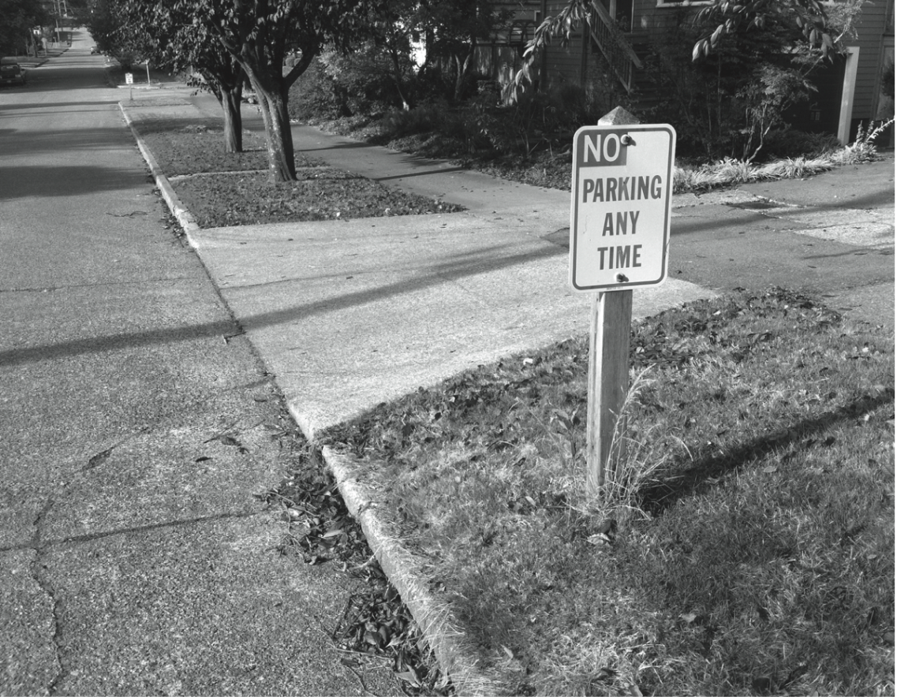
Social Contract: A Prima Facie Obligation to Obey the Law

Slide 62
Kantian Perspective
Everyone wants to be treated justly
Imagine rule: “I may break a law I believe to be unjust”
If everyone acted according to this rule, then laws would be subverted
Contradiction: Cannot both wish to be treated justly and allow laws to be subverted

Slide 63
Rule Utilitarian Perspective
What would be consequences of people ignoring laws they felt to be unjust?
Beneficial consequence: Happiness of people who are doing what they please
Harmful consequences: Harm to people directly affected by lawless actions, general loss of respect for laws, increased burden on criminal justice system
Harms greater than benefits

Slide 64
Act Utilitarian Perspective
Possible to conceive of situations where benefits of breaking law exceed harms
Suppose give penniless, bedridden friend copy of CD
Friend benefits by $15 (value of CD)
I benefit by $10 (satisfaction of helping friend)
Harms of $0 (no lost sale, no police involvement)
With $25 of benefit and $0 of harm, action is determined to be good

Slide 65
Summary

Slide 66
Insights Offered by Various Theories
Kantianism: Every person is equally valuable, and when you interact with other people you should always respect them as rational beings. It is wrong to privilege your needs and desires over those of other people.
Utilitarianism: You should consider the consequences of an action before deciding whether it’s right or wrong.
Social contract theory: We should collectively promote human rights, such as the rights to life, liberty, and property.
Virtue ethics: You can count on a good person to do the right thing at the right time in the right way.

Slide 67
It’s Up to You
You can consider duties and rights and consequences and virtues when making moral decisions
Ultimately, you have to decide:
What kind of person do I want to be?
What kind of world do I want to live in?

